Slide 1

SDN/NFV Security Monitoring
5G Network Security Infrastructure
Video 5.3

Slide 2
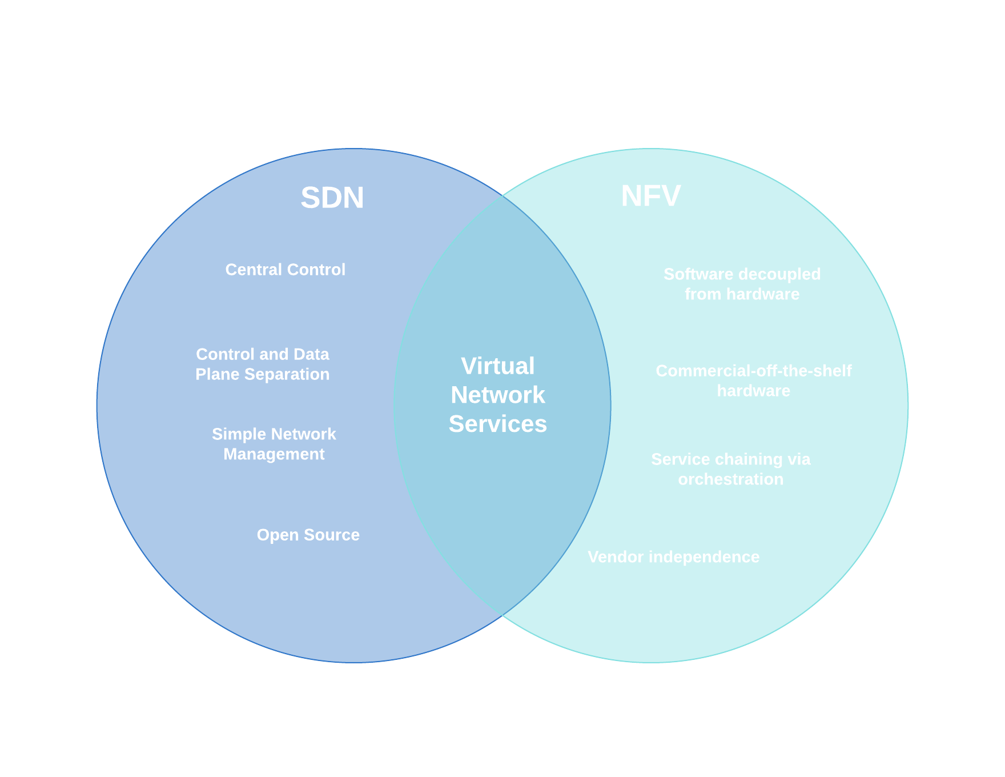

SDN / NFV Context
Software Defined Networking
Network Function Virtualization
Directly programmable
Agile
Centrally managed
Programmatically configured
Open standards-based
Software separated from hardware
Generic hardware
Agile and flexible

Slide 3
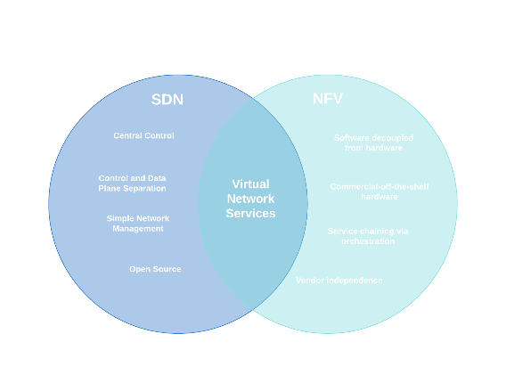

SDN/NFV in 5G SA
MEC
NRF
NSSF
AUSF
gNodeB
NEF
AMF
UDM
SMF
PCF
User Equipment (UE)
Radio Access Network (RAN)
Core Network (CN)
IP Network

Slide 4
5G SDN/NFV Threats
Security Threat | Definition | Target Point or Network Element | SDN | NFV
Denial of Service | Interruption in an authorized user's access to a computer network caused with malicious intent. | Centralized control elements | X | X
Hijacking attacks | When an intruder takes control of a session between a server and the client. | SDN controller, hypervisor (runs virtual machines) | X | X
Resource theft | Attacks that crash, hang, or otherwise interfere with the targeted program or system. | Hypervisor (runs virtual machines) |  | X
Configuration attacks | Disruption by unauthorized modification of network configurations. | SDN (virtual) switches, routers | X | X
Saturation attacks | Communication disrupted between control and data plane resulting in network-wide outage or slowness. | SDN controller and switches | X
Penetration attacks | Attack involving the use of a delivery mechanism to transport a malicious payload to the target host in the form of a Trojan horse or remote-control program. | Virtual resources | X
TCP level attacks | Tampering and terminating the Internet connection by sending a forged TCP reset packets. | SDN controller-switch communication | X
Man-in-the-Middle attacks | Attack to intercept communiction for eavesdropping or impersonation. | SDN controller-communication | X

Slide 5
Countering SDN/NFV Threats
Denial of Service Attacks and Detection
Administer at centralized control points.
Configuration verification
Verify rules in SDN switches.
Access control
Tight control and limit access to SDN as well as virtual network functions.
Traffic isolation
Ensure full isolation of traffic into “slices”.

Slide 6
Key Takeaways
01
SDN and NFV
Work seamlessly together in 5G networks.
02
Significant Threats to 5G SDN/NFV Use
Several major threats that must be addressed.
03
Approaches Exist to Mitigate Threats
Key is controlling access.

Slide 7
Securing IoT
Next Video

